Slide 1
COMPANIES AND GEOPOLICAL RISKS
OMRI Yassine
2025-2026

Slide 2
Course Content
I. Geopolitics Concepts & Definitions of Geopolitical Risk
a) Definitions
b) Concepts
c) Ten types of Geopolitical Risk
Measuring Geopolitical Risk
a) Geopolitical Risk index
b) Rating agencies
Anticipating and Assuming Geopolitical Risk
Understanding
Analysing
Mitigating
Assuming (responding)
IV. Case Study

Slide 3
Evaluation
Type | Entiltled | Duration | % of the grade
Mid-term Exam (group) | Written file + oral presentation | 30 min | 40%
Final exam (individual) | Written: Final Exam consists of two parts: 1-Theoretical questions and/or Multiple choice questions(only one Correct Answer- No Negative Points). 2- Case Study. | 120 min | 60%

Slide 4
Groupwork topics:
South China Sea
The South China Sea is a strategic hotspot marked by great-power rivalry, security tensions, and regional instability. How do these geopolitical dynamics affect international business?
2. Black Sea
competition for influence in the Black Sea, involving Russia, NATO, and the EU. What are the implications and the geopolitical risks for international business?
3. Horn of Africa
Fragmented states across the Red Sea and the Horn of Africa illustrate a region in deep crisis, characterized by armed conflict, state collapse, foreign intervention, and terrorism. What geopolitical risks does this environment pose for international business and regional stability?

Slide 5
Groupwork topics
4. The Sahel
In Mali, Burkina Faso, and Central Africa, military coups, economic fragility, terrorism, foreign military involvement, and increasing Chinese presence create a volatile geopolitical environment. What risks does this pose for international business?
5. Venezuela/ South America
The arrest of the Venezuelan president by the United States would have far-reaching geopolitical consequences and could generate a wide range of political, economic, social, and security risks. What would be the implications for global stability?

Slide 6
Geopolitic concepts and definition of GPR

Slide 7
A) Definitions
Geopolitics :
Historically, geopolitics has been used to describe the practice of states controlling and competing for territory.
In recent decades, we have also included corporate groups, non-governmental organizations, rebel groups, and political parties.
The current usage of the term “geopolitics” covers a wide range of events, with diverse causes and consequences, from terrorist attacks to climate change, and from Brexit to the global financial crisis.

Slide 8
A) Definitions
Geopolitical Risk :
Geopolitical risk can be defined as the risk associated with wars, terrorist acts, and tensions between states that disrupt the normal and peaceful course of international relations.
This definition is not exhaustive, as geopolitical risk may be understood differently by different actors.

Slide 9
A) Definitions
For Companies and Business Operations:
Geopolitical risk (GPR) refers to the probability that political actions or events will significantly affect a company’s business activities.
Such political actions affecting businesses can occur at all levels—from the domestic environment and public spaces to international markets and foreign operations.

Slide 10
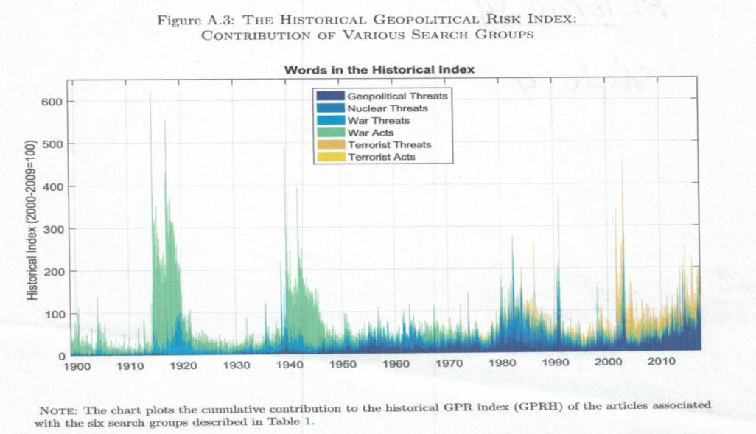

Slide 11
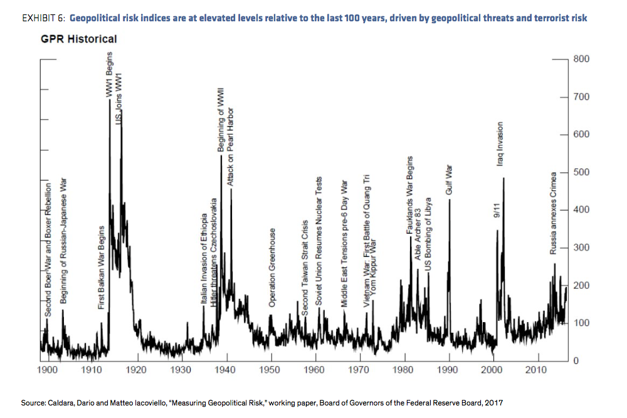

Slide 12
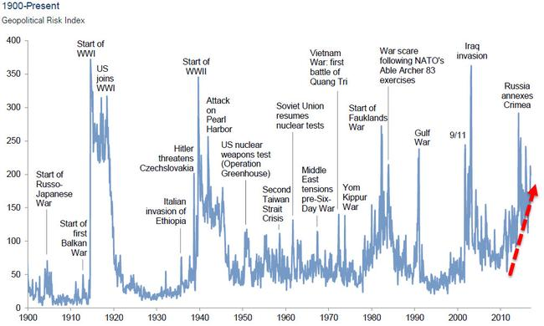

Slide 13
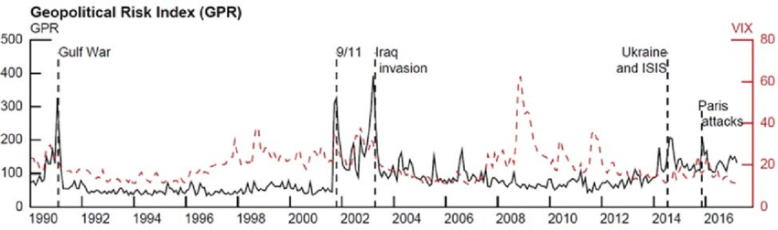

Slide 14
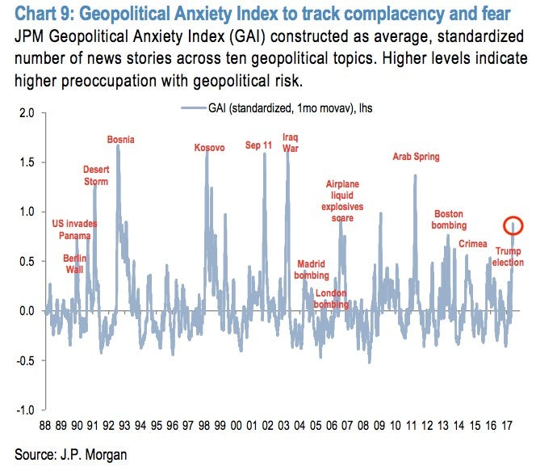

Slide 15
B) Concepts
We can identify five levels of actors whose actions generate geopolitical risk (GPR) for businesses:
Individuals
Local organizations
National government actors and state institutions
Transnational groups
Supranational and international institutions

Slide 16
B) Concepts
Individual :
Such as :
Twitter Users
Documentary films
Celebrities, ordinary citizens
Hackers, Activists
Exemples :
United Airlines oversold its afternoon flight on April 9, 2017, and the company decided to remove four passengers at random but the police officers forcibly removed one passenger, by pulling him, causing him personal injury, this problem has an international impact.
https://www.youtube.com/watch?v=uRhnBsiIjqQ
https://www.youtube.com/watch?v=WEw-GjTriIo
https://www.youtube.com/watch?v=XFLG88iANrk
Dolce & Gabbana produced an ad featuring an Asian woman eating Italian dishes with chopsticks, the Chinese people were shocked, and Dolce & Gabbana had to cancel her fashion show following this story.
https://www.youtube.com/watch?v=TBFC5isQuYA

Slide 17
B) Concepts
2. Local Organisation
Such as neighborhood associations, political groups, and local governments, labor union
Example: Iran Sanctions
3. National government actors and their Institutions
Such as presidents, executive agencies, legislatures, and the judiciary.
Example : Venezuella Case

Slide 18
B) Concepts
4. Transnational group
Such as activists, terrorists, hackers, criminals, militaries and ethnic religions communities.
Example: In June 2017 : cyber attack Called « Not Petya » disabled computer systems worldwide.
5. Supranational and International Institutions
Such as the European Union and United Nations
Example: United Nations and Iran

Slide 19
C)- Ten types of Geopolitical risk
Interstate Wars (e.g. U.S.–Iraq war and its impact on Dow Corning)
International Conflicts and Humanitarian Crises (e.g. refugee flows)
Laws, Regulations, and Public Policies (e.g. San Leon Energy in Poland)
Breaches of Contract and Expropriation (e.g. under Chávez in Venezuela)
Corruption and Political Scandals (e.g. Halliburton)
Extraterritorial Application of Law (e.g. Total’s activities in Iran)
Manipulation of Natural Resources (e.g. OPEC)
Social Activism and Civil Society Pressure (e.g. Nestlé)
Terrorism and Political Violence (e.g. Cantor Fitzgerald)
Cyber Threats and Cyberattacks (e.g. Sony)

